Slide 1
HTML Basic Tags

Slide 2
Heading Tags
Any document starts with a heading.
You can use different sizes for your headings.
HTML also have six levels of headings, which use the elements <h1>, <h2>, <h3>, <h4>, <h5>, and <h6>.
While displaying any heading, browser adds one line before and one line after that heading.

Slide 3
Heading Tags
<html>
<head>
<title>Heading Example</title>
</head>
<body>
<h1>This is heading 1</h1>
<h2>This is heading 2</h2>
<h3>This is heading 3</h3>
<h4>This is heading 4</h4>
<h5>This is heading 5</h5>
<h6>This is heading 6</h6>
</body>
</html>

Slide 4
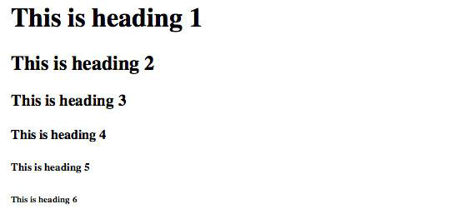
Heading Tags
This will produce following result:

Slide 5
Paragraph Tag
The <p> tag offers a way to structure your text into different paragraphs.
Each paragraph of text should go in between an opening <p> and a closing </p> tag as shown below in the example:

Slide 6
Paragraph Tag
<html>
<head>
<title>Paragraph Example</title>
</head>
<body>
<p>Here is a first paragraph of text.</p>
<p>Here is a second paragraph of text.</p>
<p>Here is a third paragraph of text.</p>
</body>
</html>

Slide 7

Paragraph Tag
This will produce following result:

Slide 8
Line Break Tag
Whenever you use the <br /> element, anything following it starts from the next line.
This tag is an example of an empty element, where you do not need opening and closing tags, as there is nothing to go in between them.

Slide 9
Line Break Tag
The <br /> tag has a space between the characters br and the forward slash.
If you omit this space, older browsers will have trouble rendering the line break, while if you miss the forward slash character and just use <br> it is not valid in XHTML

Slide 10
Line Break Tag
<html>
<head>
<title>Line Break Example</title>
</head>
<body>
<p>Hello<br />
You delivered your assignment on time.<br />
Thanks<br />
Mahnaz</p>
</body>
</html>

Slide 11
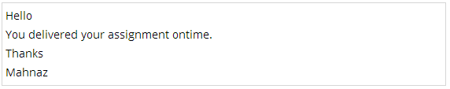
Line Break Tag
This will produce following result:

Slide 12
Centering Content
You can use <center> tag to put any content in the center of the page or any table cell.

Slide 13
Centering Content
<html>
<head>
<title>Centring Content Example</title>
</head>
<body>
<p>This text is not in the center.</p>
<center>
<p>This text is in the center.</p>
</center>
</body>
</html>

Slide 14

Centering Content
This will produce following result:

Slide 15
Horizontal Lines
Horizontal lines are used to visually break up sections of a document.
The <hr> tag creates a line from the current position in the document to the right margin and breaks the line accordingly.
For example, you may want to give a line between two paragraphs as in the given example below:

Slide 16
Horizontal Lines
<html>
<head>
<title>Horizontal Line Example</title>
</head>
<body>
<p>This is paragraph one and should be on top</p>
<hr />
<p>This is paragraph two and should be at bottom</p>
</body>
</html>

Slide 17

Horizontal Lines
This will produce following result:

Slide 18
Horizontal Lines
Again <hr /> tag is an example of the empty element, where you do not need opening and closing tags, as there is nothing to go in between them.

Slide 19
Horizontal Lines
The <hr /> element has a space between the characters hr and the forward slash.
If you omit this space, older browsers will have trouble rendering the horizontal line, while if you miss the forward slash character and just use <hr> it is not valid in XHTML.

Slide 20
Preserve Formatting
Sometimes you want your text to follow the exact format of how it is written in the HTML document.
In those cases, you can use the preformatted tag <pre>.
Any text between the opening <pre> tag and the closing </pre> tag will preserve the formatting of the source document.

Slide 21
Preserve Formatting
<html>
<head>
<title>Preserve Formatting Example</title>
</head>
<body>
<pre>
function testFunction( strText ){
alert (strText)
}
</pre>
</body>
</html>

Slide 22

Preserve Formatting
This will produce following result:
Try using same code without keeping it inside <pre>...</pre> tags.

Slide 23
Nonbreaking Spaces
Suppose you want to use the phrase "12 Angry Men."
Here you would not want a browser to split the "12, Angry" and "Men" across two lines:

Slide 24
Nonbreaking Spaces
In cases where you do not want the client browser to break text, you should use a nonbreaking space entity &nbsp; instead of a normal space.
For example, when coding the "12 Angry Men" in a paragraph, you should use something similar to the following code:

Slide 25
Nonbreaking Spaces
<html>
<head>
<title>Nonbreaking Spaces Example</title>
</head>
<body>
<p>An example of this technique appears in the movie "12&nbsp;Angry&nbsp;Men."</p>
</body>
</html>

